Slide 1
All About My Project Idea
Lakshmi Manohar M | FSJ0420A109

Slide 2
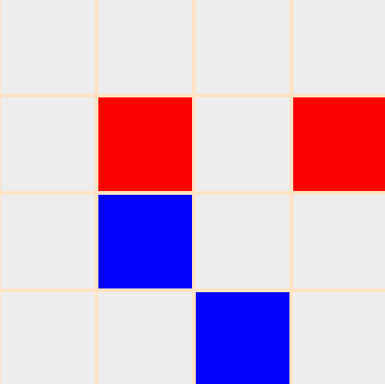
About The Project
The Memory Game is game that requires players to match similar color. As the color implies, participants need to find a match for an same color.

Slide 3
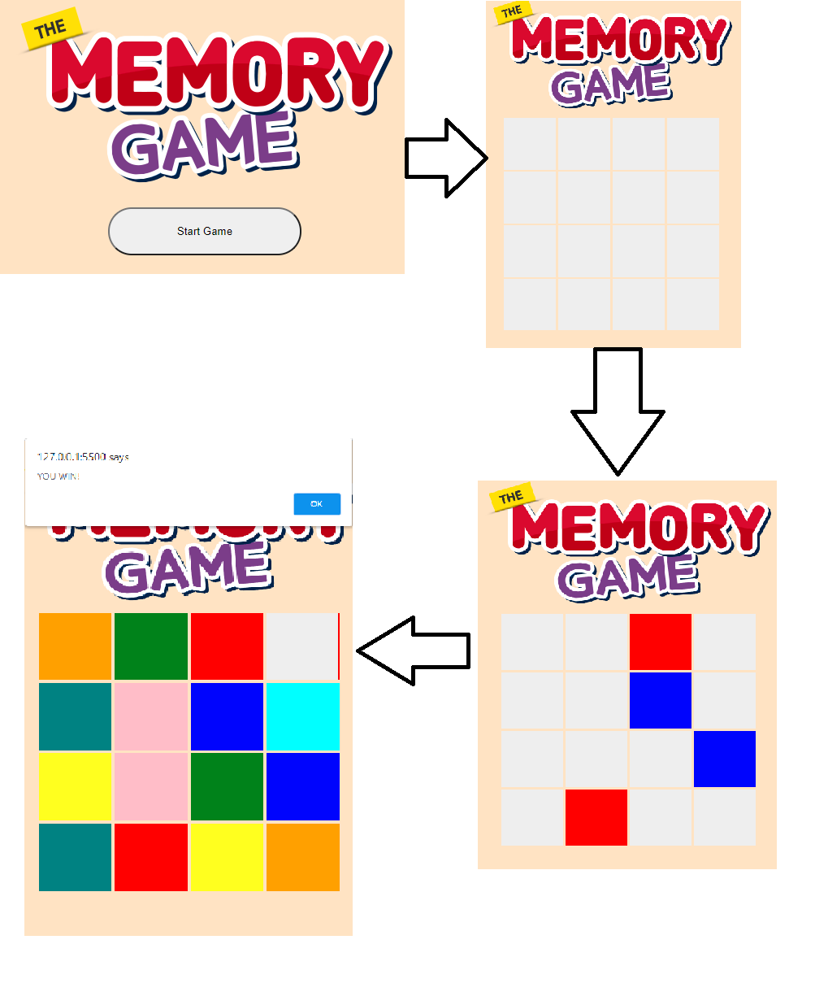
Wire Freames

Slide 4
Project Implementation Plan
Feature/Module | Finish Date
HTML
CSS Styling
JavaScript

Slide 5

Thank You

